Slide 1
Introduction

Slide 2
Four-Dimensions of Data Mining
Data to be mined
Knowledge to be discovered
Techniques utilized
Applications adopted

Slide 3
Four-Dimensions of Data Mining
Data to be mined
Knowledge to be discovered
Techniques utilized
Applications adopted

Slide 4
Towards Real-World Data
You may have learned how to collect, store, and process data with Python data structures and tools (e.g., arrays, lists, hash tables, Numpy, Pandas, databases)
Notes:
Through programming and data manipulation courses, you may have learned how to collect, store, and process data with programming tools. These include data structures such as arrays, lists, and hash tables, Python packages such as Numpy and Pandas, or computational systems like databases.

Slide 5
Towards Real-World Data
You may have learned how to collect, store, and process data with Python data structures and tools -- these are designed for data storage and processing, but not sufficient for data mining.
Notes:
These tools make data management convenient, but they are insufficient for data mining tasks.

Slide 6
Towards Real-World Data
You may have learned how to collect, store, and process data with Python data structures and tools -- these are not sufficient for data mining.
Data, in reality, are not simple.
Notes:
On one hand, data in real world scenarios are often complex, messy, noisy, and they usually mixes heterogeneous types of information. It is not clear what single data structure one should use to manage them.

Slide 7
Towards Real-World Data
You may have learned how to collect, store, and process data with Python data structures and tools -- these are not sufficient for data mining.
Data, in reality, are not simple.
There is a big gap between real data and analytics.
Notes:
On the other hand, even if one can load the data to your Jupyter notebook, there is still a big gap between programming the data and mining the data through various algorithms.

Slide 8
Towards Real-World Data
You may have learned how to collect, store, and process data with Python data structures and tools -- these are not sufficient for data mining.
Data, in reality, are not simple.
There is a big gap between real data and analytics.
Data representation bridges this gap.
Notes:
We need something to bridge the gap; and that is what we call data representation.

Slide 9
Data Representation
A mathematical way to describe what data look like.
Notes:
A data representation is a mathematical way to describe what your data look like,

Slide 10
Real world scenarios
Notes:
Let us first take a look at a few real world scenarios to get a sense of the heterogeneity of real world data.

Slide 11
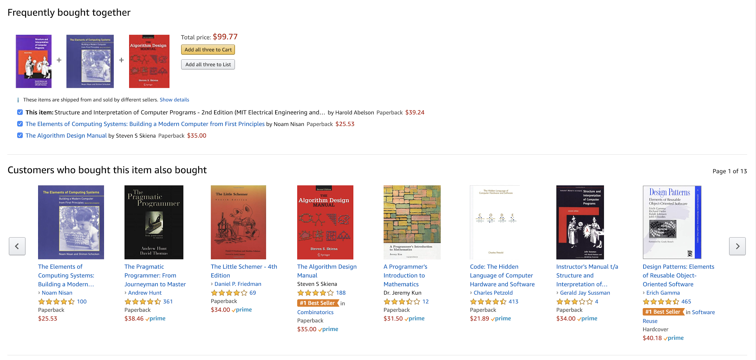
Notes:
Let’s think about the recommendations you receive everyday when you shop at Amazon. What kind of data are involved in the scenario?

Slide 12
Notes:
We see a few book titles and cover images,

Slide 13
Notes:
we also see ratings and prices, and we see categories and tags.

Slide 14

Notes:
If we click on the ratings we’ll also see buyers and reviews.

Slide 15
How do we generate recommendations from such complex and messy information?
Notes:
How can we figure out which books should be recommended to a given book, base on such complex and messy information?

Slide 16
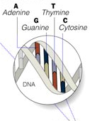
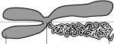
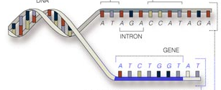
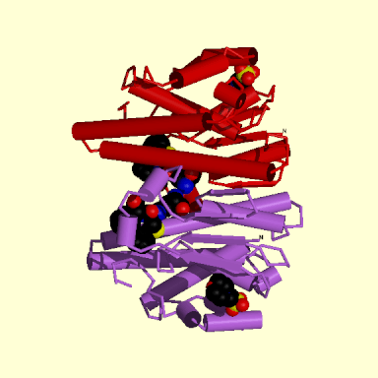
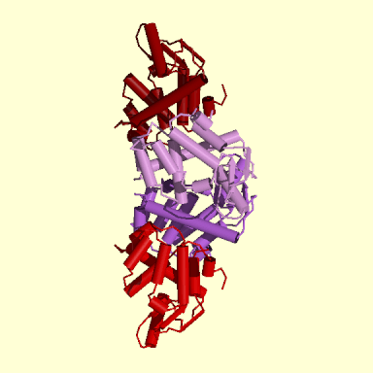
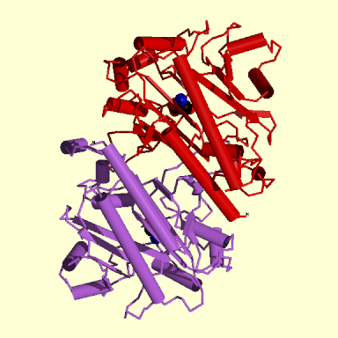
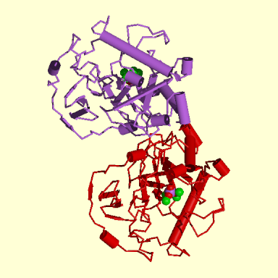
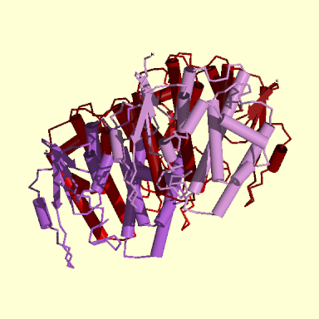
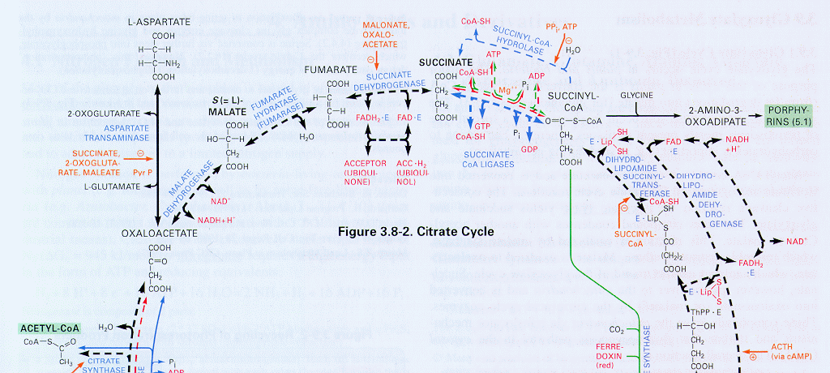
Citrate Cycle
Image source: Albert-László Barabási’s SIGIR09 keynote
Notes:
Here is another example. Some of you may have been dealing with biological data. But when you talk about biological data,

Slide 17
Citrate Cycle
Image source: Albert-László Barabási’s SIGIR09 keynote
Notes:
are you talking about the DNA sequences?

Slide 18
Citrate Cycle
Image source: Albert-László Barabási’s SIGIR09 keynote
Notes:
the molecular structures?

Slide 19
Citrate Cycle
Image source: Albert-László Barabási’s SIGIR09 keynote
Notes:
chemical compounds, their interactions, or various types of experimental results?

Slide 20
What python data structure would you use to load this complex data?
Citrate Cycle
Image source: Albert-László Barabási’s SIGIR09 keynote
Notes:
What python data structure would you use to load this complex data?

Slide 21

Image source: - https://en.wikipedia.org/wiki/File:Internet_map_1024.jpg The Opte Project - CC-BY 2.5 Generic
Notes:
For another example, the internet we are familiar with consists of many servers and terminals.

Slide 22
Image source: - https://en.wikipedia.org/wiki/File:Internet_map_1024.jpg The Opte Project - CC-BY 2.5 Generic
Notes:
These nodes are interconnected with each other, forming this huge complex system. Data of the internet not only contain information about the network structure, but also include the content that flow on these nodes and links.

Slide 23
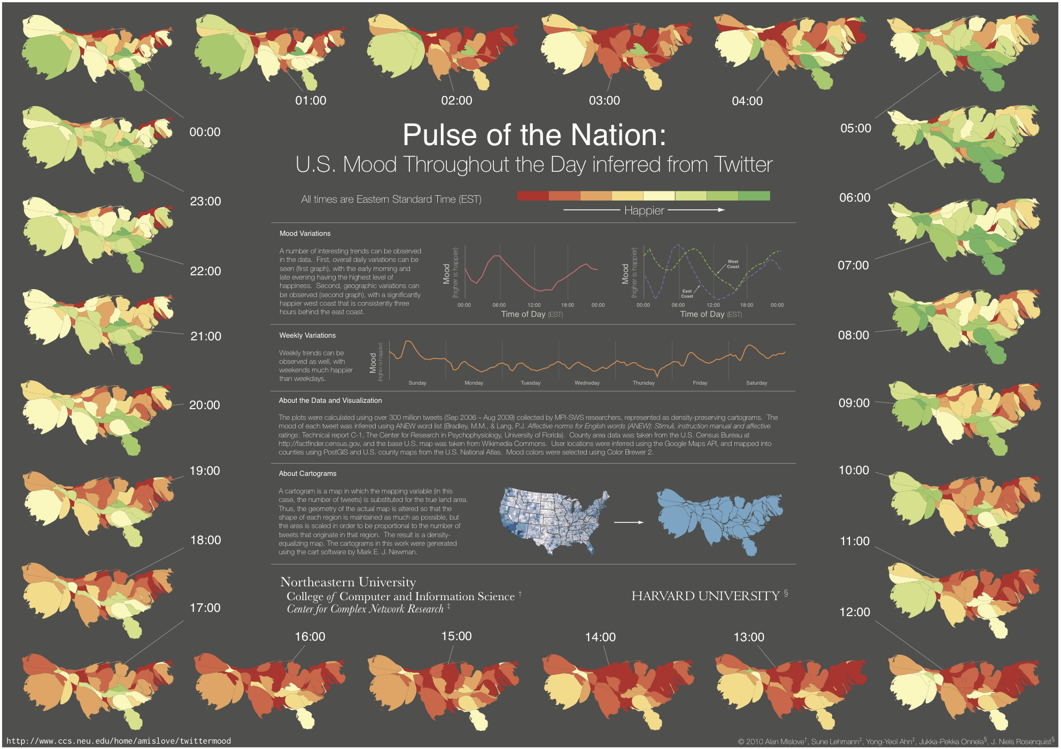
Pulse of the Nation - Alan Mislove, Sune Lehmann, Yong-Yeol Ahn, Jukka-Pekka Onnela, J. Niels Rosenquist - https://mislove.org/twittermood/ - CC BY 3.0

Slide 24



Challenge of Real Data
What we are used to:
Binary Code - Christiaan Colen - https://www.flickr.com/photos/christiaancolen/20607150556 - CC BY SA 2.0

Slide 25

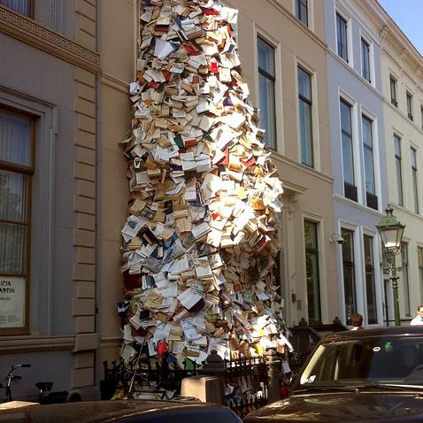
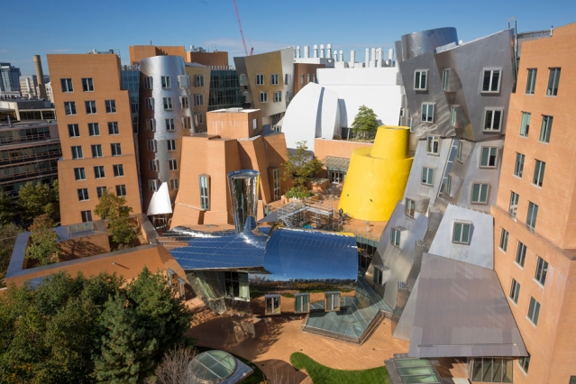
Challenge of Real Data
What we are used to:
What the reality is:
overflowing - zoetnet - https://www.flickr.com/photos/zoetnet/7929093836 - CC-BY-2.0
Binary Code - Christiaan Colen - https://www.flickr.com/photos/christiaancolen/20607150556 - CC BY SA 2.0
Stata Center MIT - King of Hearts - https://commons.wikimedia.org/wiki/File:Stata_Center_MIT_October_2014.jpg - CC-BY-SA-3.0

Slide 26
So, how to deal with the wild thing?
Volume, Variety, and Velocity

Slide 27
Data Formulation
There are more data science applications than you may expect.
But there aren’t so many basic data types.
How shall we abstract, formulate, represent the data in real applications?
Data formulation is usually the first task of data mining

Slide 28
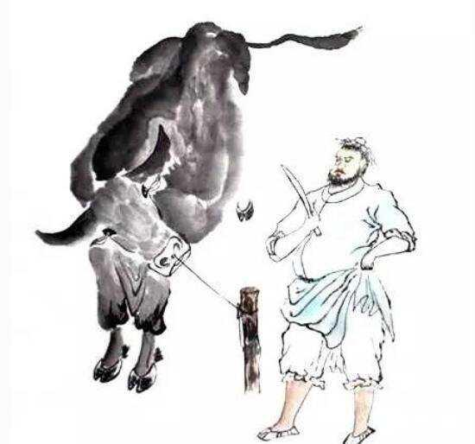
The Skillful Butcher (Story by Chuang-Tzu, ~300 BC)
Image source - https://zi.media/@whyhtd01com/post/Ksx4kt

Slide 29
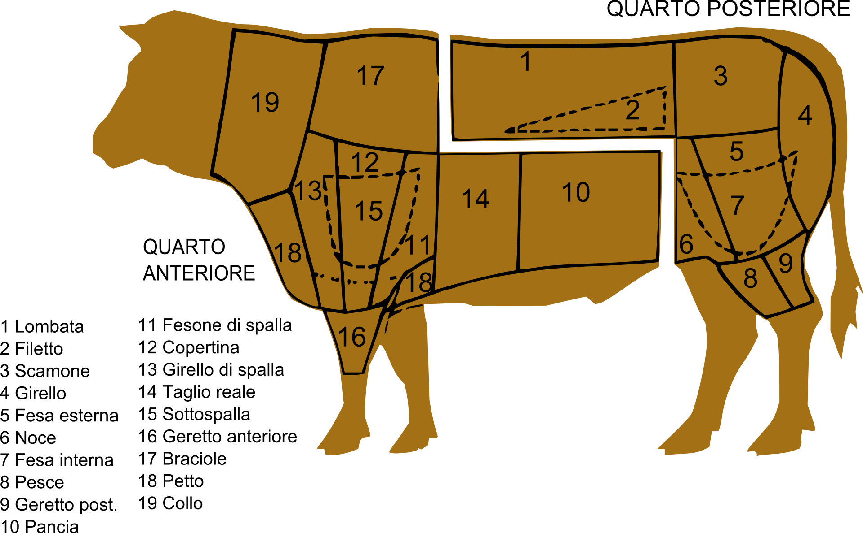
The Skillful Butcher (Story by Chuang-Tzu, ~300 BC)
Tagli bovino - Ddd0 https://commons.wikimedia.org/wiki/File:Tagli_bovino.svg - CC-BY--3.0
Image source - https://zi.media/@whyhtd01com/post/Ksx4kt

Slide 30
What does a Data Scientist See?

Slide 31
What does a Data Scientist See?
What is a basic object of information?

Slide 32
What does a Data Scientist See?
What is a basic object of information?
What are the properties/attributes of the data object?

Slide 33
What does a Data Scientist See?
What is a basic object of information?
What are the properties/attributes of the data object?
How are the attributes structured?

Slide 34
What does a Data Scientist See?
What is a basic object of information?
What are the properties/attributes of the data object?
How are the attributes structured?
How to assign values to the attributes?

Slide 35
What does a Data Scientist See?
What is a basic object of information?
What are the properties/attributes of the data object?
How are the attributes structured?
How to assign values to the attributes?
How are different data objects related?

Slide 36
What does a Data Scientist See?
What is a basic object of information?
What are the properties/attributes of the data object?
How are the attributes structured?
How to assign values to the attributes?
How are different data objects related?
Data scientists must be able to answer these questions in a mathematical way

Slide 37
What does a Data Scientist See?
What is a basic object of information?
What are the properties/attributes of the data object?
How are the attributes structured?
How to assign values to the attributes?
How are different data objects related?
Representation of data allow data scientists to answer in a mathematical way

Slide 38


School of Information, University of Michigan
Qiaozhu Mei
School of Information
All Content © Presenter

